Slide 1
Design of Low Power TPG Using LP-LFSR

Slide 2
contents
Introduction
Problem Statement
Objectives
Literature Review
Test Pattern Generator (TPG)
LFSR
Proposed Low Power TPG Architecture
Flow chart
Tools and Technologies Used
RTL Design and Implementation
Simulation Results
Advantages &disadvantages
Applications
Conclusion
Future Scope
References

Slide 3

introduction
VLSI circuits require efficient testing methods.
Built-In Self Test (BIST) is widely used for testing digital circuits.
Linear Feedback Shift Registers (LFSR) are commonly used for Test Pattern Generation.
However, conventional LFSR produces high switching activity.
High switching activity increases dynamic power consumption during testing.

Slide 4

Problem statement
During test mode, VLSI circuits consume more power than in normal operation.
Conventional LFSR-based TPG generates pseudo-random patterns with multiple bit transitions.
Multiple input transitions increase switching activity at the Circuit Under Test (CUT).
High switching activity leads to increased dynamic power consumption.
There is a need to reduce switching activity without affecting randomness and fault coverage.
$$P =\frac{1}{2}C V^{2}f α$$
Where:
$C$= Load Capacitance
$V$= Supply Voltage
$f$= Frequency
$α$= Switching Activity

Slide 5
objective
Design a Low Power Test Pattern Generator (TPG).
Reduce switching activity between test vectors.
Implement LP-LFSR architecture.
Apply test patterns to Braun Array Multiplier (CUT).
Compare power consumption with conventional LFSR.

Slide 6
Literature Review
Author / Year | Method / Technique | Key Idea | Limitation
P. Girard (2002) | Low Power Testing of VLSI Circuits | Identified switching activity as the major factor affecting dynamic power during testing | Does not provide a specific low power test pattern generator
Wang & Gupta (2002) | DS-LFSR (Dual Speed LFSR) | Proposed LFSR structure with reduced switching activity in test patterns | Power reduction limited for large circuits
Girard et al. (2001) | Modified Clock Scheme for BIST | Reduced power by controlling clock activity in flip-flops | Increases hardware complexity
Kavitha et al. (2021) | Low Power TPG using LP-LFSR | Combines LP-LFSR, Gray code generator and counter to generate single-input change patterns | Requires additional hardware blocks

Slide 7
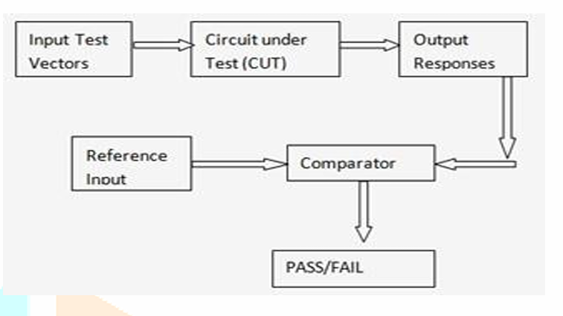
tpg –test pattern generator
Definition
A Test Pattern Generator (TPG) is a circuit used to generate test vectors that are applied to the Circuit Under Test (CUT) for detecting faults during testing.
Purpose
Generates input test patterns for digital circuits.
Helps detect faults during testing.
Enables automatic testing in Built-In Self-Test (BIST) systems.

Slide 8
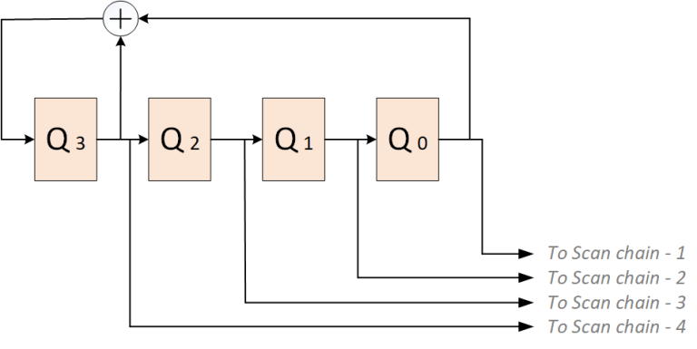
LFSR – linear feedback shift register
Conventional Test Pattern Generator uses Linear Feedback Shift Register (LFSR).
LFSR generates pseudo-random test patterns.
Multiple bits change between consecutive patterns.
High switching activity at CUT inputs.
Leads to increased dynamic power during test mode.

Slide 9
Proposed Low Power TPG Architecture
A Low Power Test Pattern Generator is proposed.
It reduces switching activity during test mode.
Architecture consists of:
LP-LFSR with Synchronous Clock Enable
m-bit Counter
Gray Code Generator
XOR Array
Gray code ensures single input change.
LP-LFSR provides pseudo-random seed.
Final output is low-transition test pattern.

Slide 10
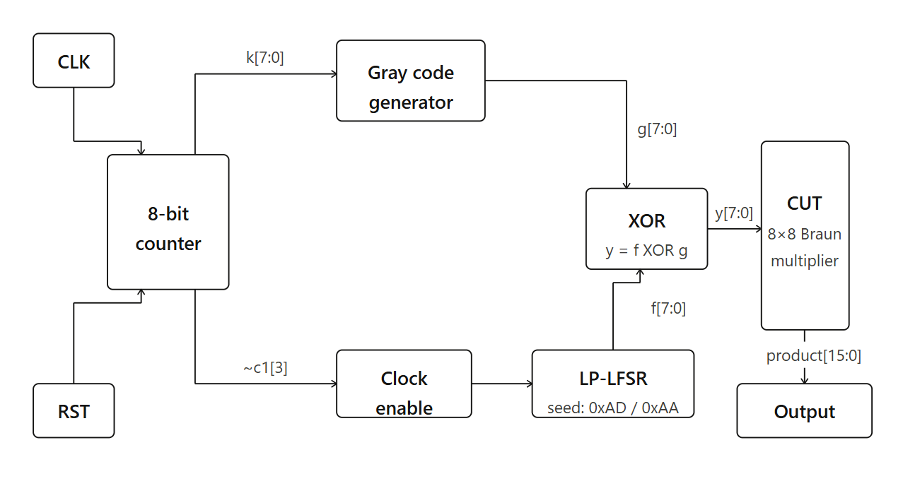
Block diagram

Slide 11
Flow chart
Start
Initialize
RST=1,counter=0,LFSR=SEED
Release reset (RST=0)Counter starts on CLK
Counter increments
count[7:0] = count + 1 per CLK
~c1[3]=1?
Gray code g[7:0] from k[7:0]]
Advance LP-LFSR f[7]=f[1] XOR f[0]
XOR array y[7:0] = f XOR g
Apply to CUT y[7:0] → Braun array multiplier
Done?
End

Slide 12


Modules details
Main Modules Implemented
1️⃣ m-bit Counter
Generates binary sequence
$k\left[m−1:0\right]$
Counts from 0 to ($2^{m}−1)$
Controlled by clock signal
2️⃣ Gray Code Generator
Converts binary to Gray code
Ensures single bit transition
Implemented using:
$g\left[n−1\right]=k\left[n−1\right]$
$g\left[i\right]=k\left[i\right]⊕k\left[i+1\right]$
3️⃣ Modified LP-LFSR
Generates pseudo-random seed
Contains feedback XOR logic
Includes swapping mechanism (low transition logic)
4️⃣ XOR Array
Performs bitwise XOR
Final output:
$x\left[i\right]=f\left[i\right]⊕g\left[i\right]$

Slide 13
TOOLS AND TECHNOLOGIES USED
Hardware Platform • Target FPGA Device: Xilinx Artix-7 • Device Model: xc7a35tcpg236-1
Design Language • Verilog HDL
EDA Tool • Xilinx Vivado 2025.1
Simulation • Behavioural Simulation for functional verification
Design Flow • RTL Design → Simulation → Synthesis → Implementation → Power Analysis

Slide 14
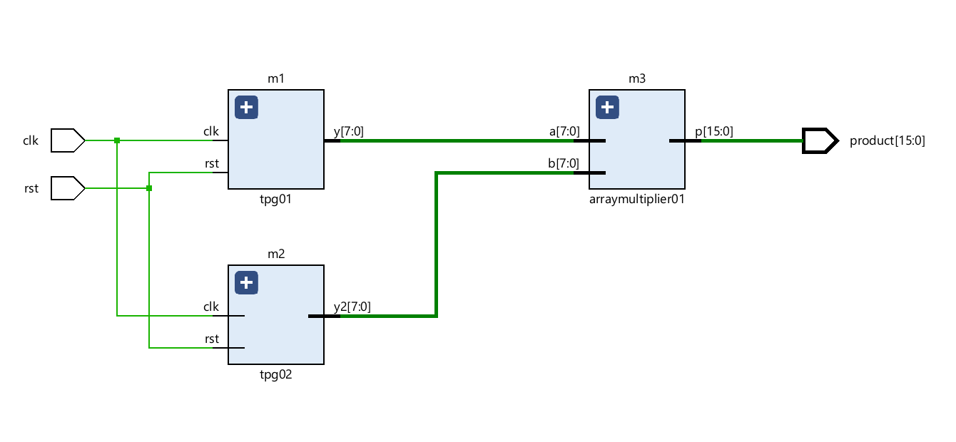
RTL Design and Implementation
LP-TPG architecture designed using Verilog HDL
Modules implemented: LP-LFSR, Counter, Gray Code Generator, XOR
Design synthesized using Xilinx Vivado 2025.1
Target FPGA device: Artix-7 (xc7a35tcpg236-1)
RTL schematic generated to verify module connectivity

Slide 15
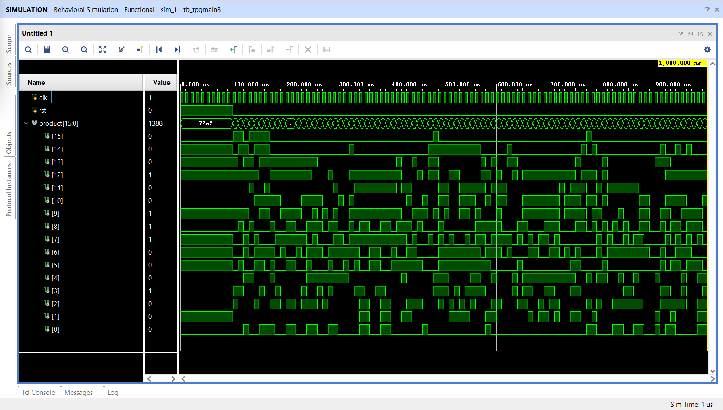
Simulation results

Slide 16
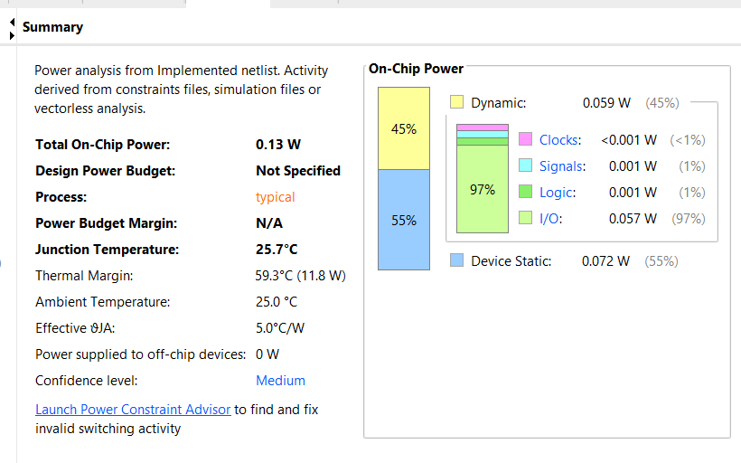
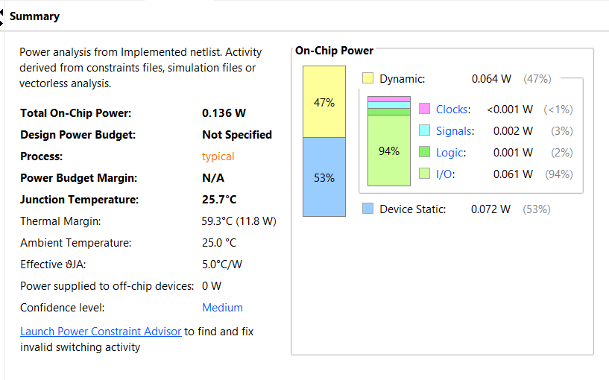
Power analysis report generated using Vivado Power Analyzer for LP-TPG
Power analysis report generated using Vivado Power Analyzer for conventional TPG

Slide 17
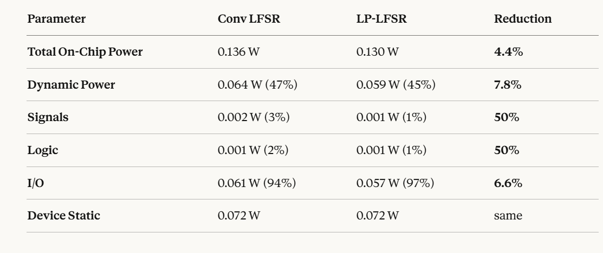

Slide 18
Advantages & disadvantages
advantages
disadvantages
Reduced switching activity using Gray code
Significant reduction in test power
Maintains good fault coverage
Simple and BIST compatible architecture
Suitable for FPGA and SoC designs
Slight increase in hardware overhead
More control logic than conventional LFSR
Slower seed update (once every 2ᵐ cycles)
Clock enable condition fixed to
counter bit c1[3] — not dynamically adjustable Pseudo-random, not truly random
CUT must be much larger than TPG

Slide 19
applications
Built-In Self-Test (BIST) for VLSI circuits
Testing of System-on-Chip (SoC) designs
Low power testing of digital signal processing (DSP) blocks
FPGA-based embedded systems testing
Portable and battery-powered electronic devices
ASIC testing with reduced peak power

Slide 20
conclusion
LP-TPG based on LP-LFSR architecture was studied and implemented.
Gray code technique reduces switching transitions between test patterns.
Reduced switching activity leads to lower dynamic power consumption.
Architecture is suitable for BIST applications in VLSI systems.
FPGA-based implementation validates feasibility of the design.

Slide 21
Future scope
Implementation on advanced FPGA platforms.
Extension to larger multipliers (16×16, 32×32) and complex DSP blocks.
Integration with full BIST architecture including response analyzer.
Optimization for further reduction of peak power consumption.
ASIC-level implementation and comparison with other low-power TPG techniques.
Exploration of adaptive or clock-gated LP-LFSR designs.

Slide 22
references
• A. Kavitha, G. Seetharaman, T. N. Prabakar, and S. Shrinithi, “Design of Low Power Test Pattern Generator Using LP-LFSR,” International Conference on Intelligent Systems Modelling and Simulation, IEEE, 2012.
• P. Girard, “Survey of Low-Power Testing of VLSI Circuits,” IEEE Design & Test of Computers, vol. 19, no. 3, pp. 80–90, 2002.
• S. Wang and S. K. Gupta, “DS-LFSR: A BIST TPG for Low Switching Activity,” IEEE Transactions on Computer-Aided Design of Integrated Circuits and Systems, 2002.
• Xilinx Inc., Vivado Design Suite User Guide, 2025.

